Slide 1
System Panic
Presenters:
Layla Hoey - Producer
Antony Pinto - Level Design Lead

Slide 2
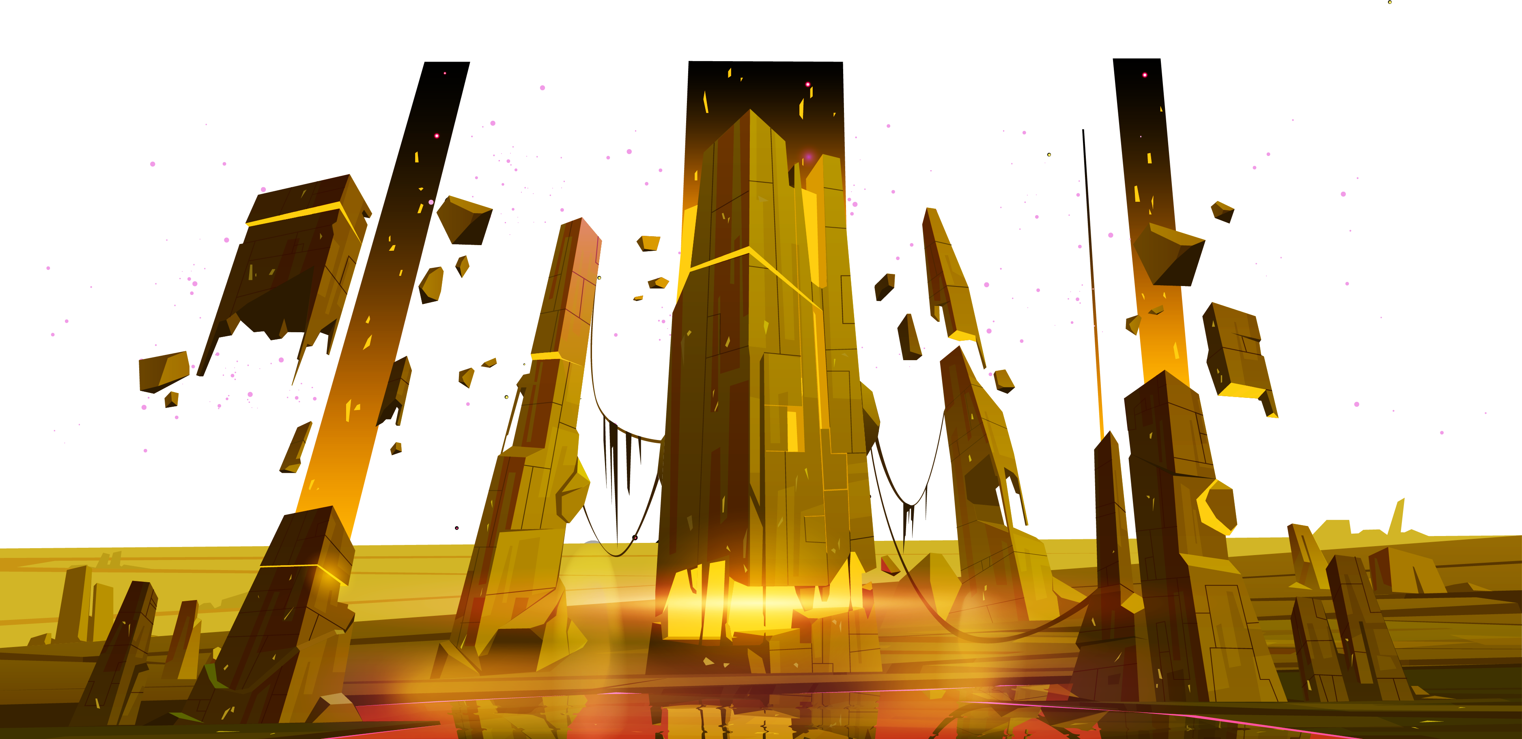
Game Concept

Slide 3

Design Pillars
High replay value
Emergent strategy
Procedural Generation
RNG
Choose-your-own difficulty
Very sparse checkpoints
High risk, High reward
On losing, player feels responsible; “I should have done x instead of y!”
On winning, player feels like a genius; “I played it just right!”
Accessible → 1 job: Defeat monsters.
Retro aesthetic
Limited Menus
Player has access to all relevant game information through visual representations
Run-based
Challenging
Arcade-y

Slide 4
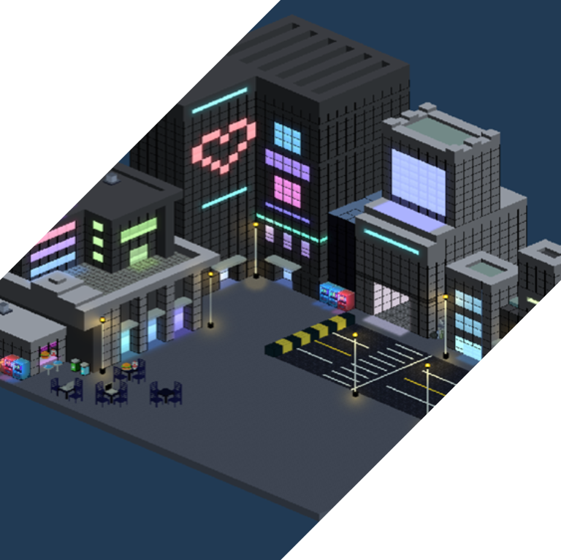
Core Concept
Aliens are here.
They have imposed an RPG-style game system upon the inhabitants of Earth.
FIGHT!

Slide 5
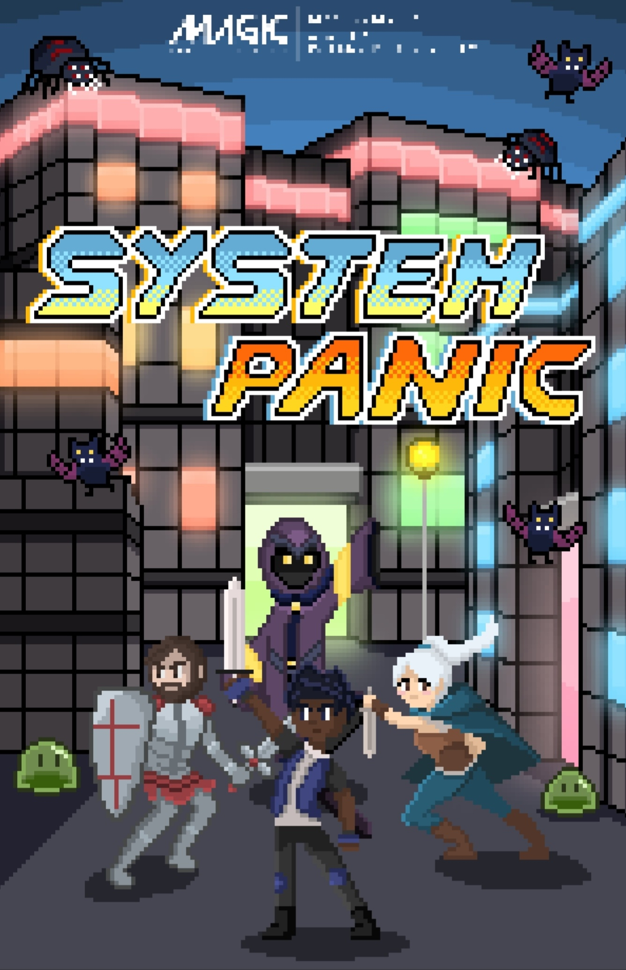

Poster
Special thanks to
Purrfect Tactics’ own:
Bianca!!

Slide 6
Art

Slide 7
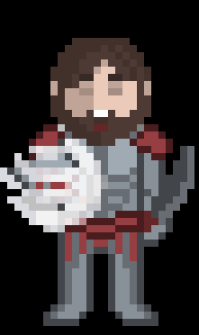
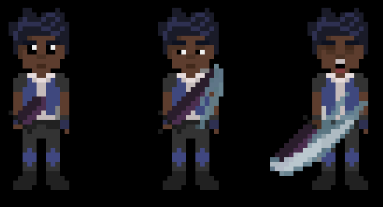
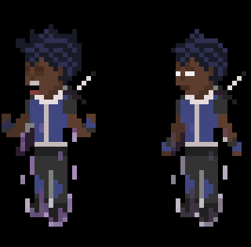
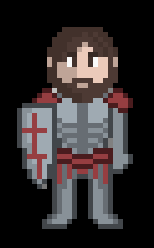
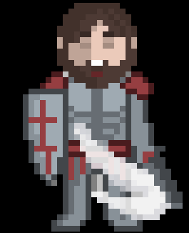
Player Art
Fighter
Tank

Slide 8

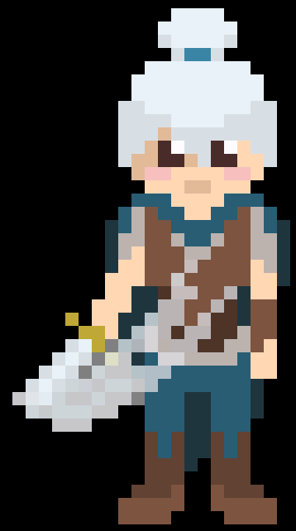
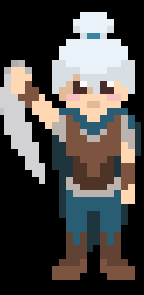
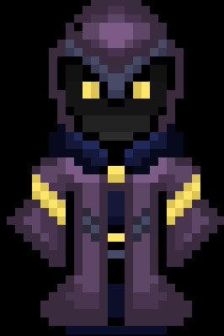

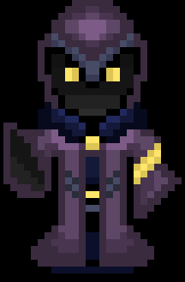
Rogue
Mage

Slide 9
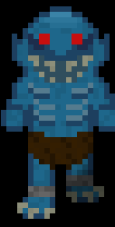
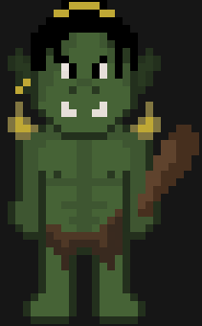
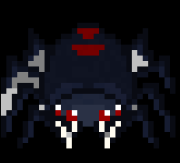

Art - Enemies
Spider
Slime
Ghoul
Orc

Slide 10
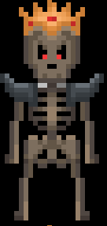
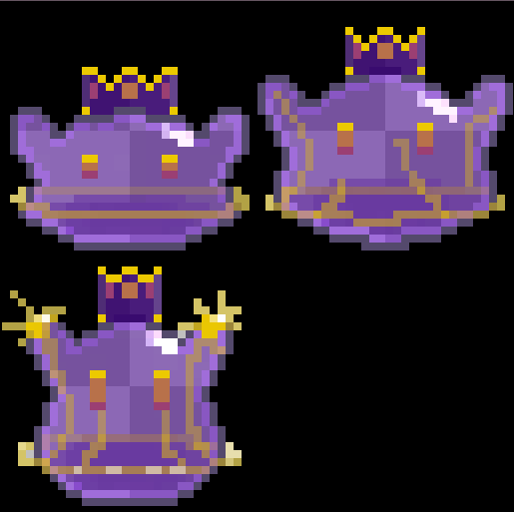
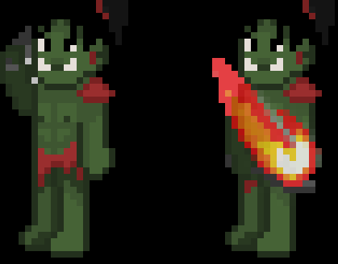
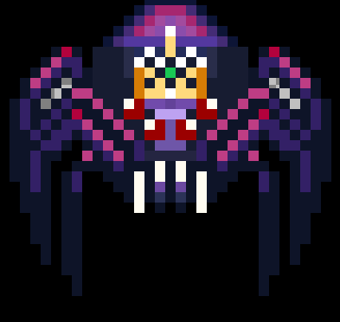
King Skeleton
King Slime
King Orc
Queen Spider
Art - Bosses

Slide 11
Level Design

Slide 12
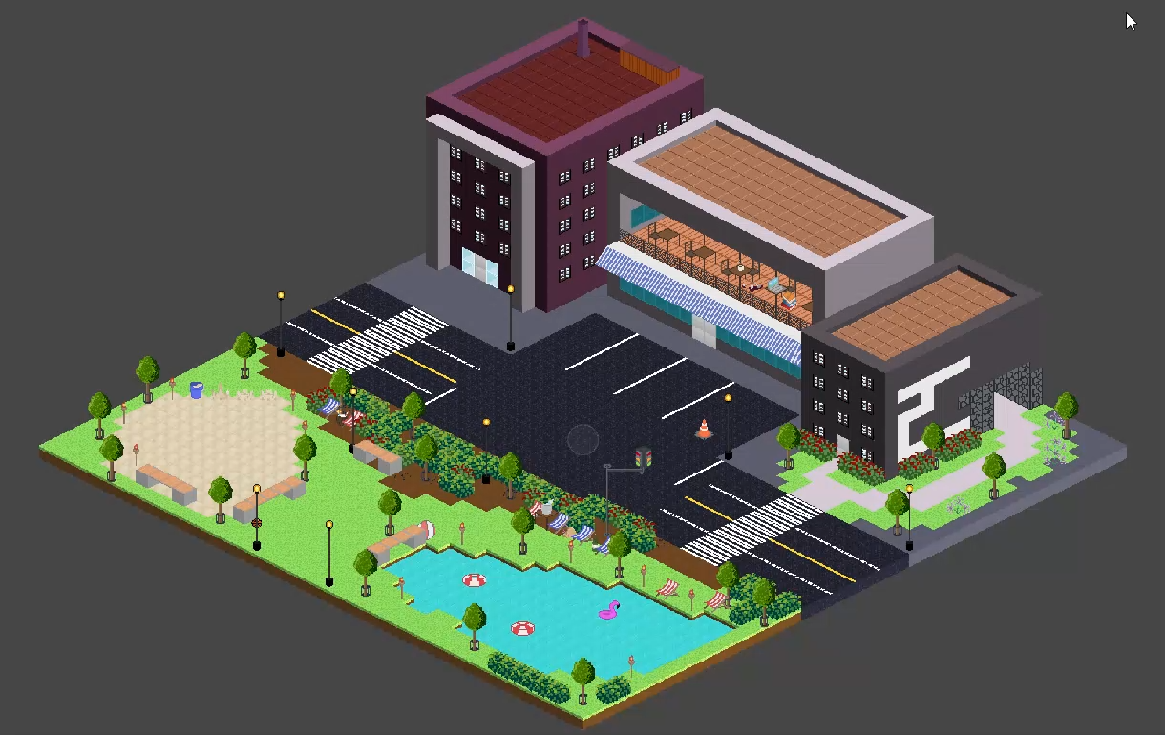
Lighting and Post Processing

Slide 13
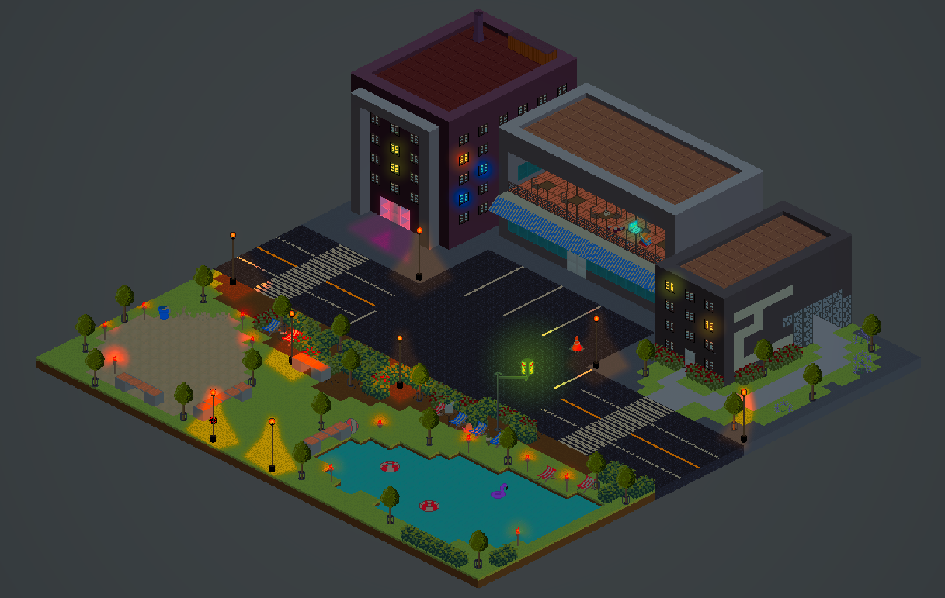
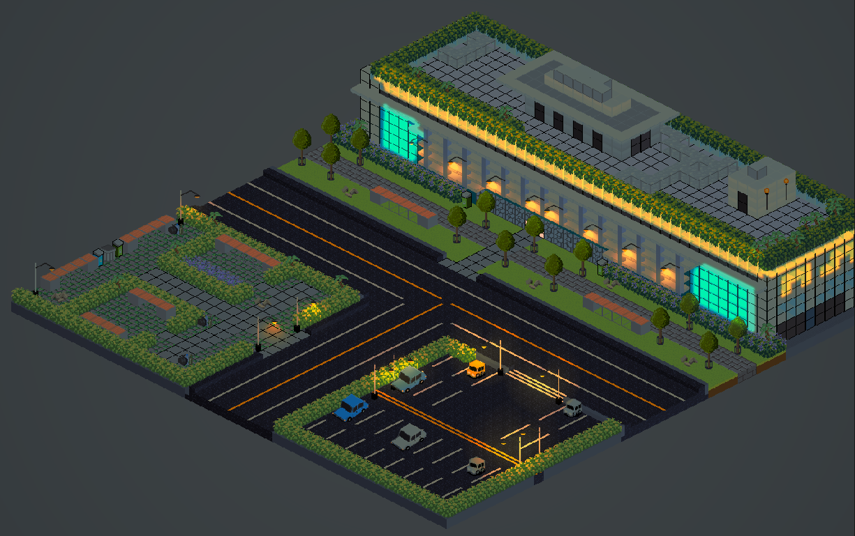
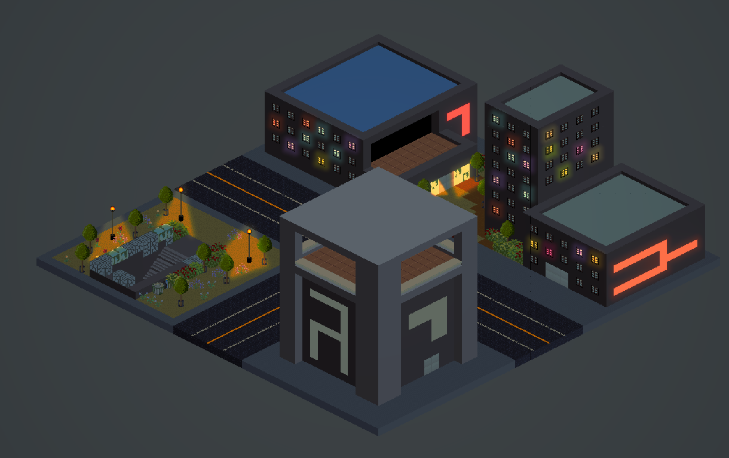
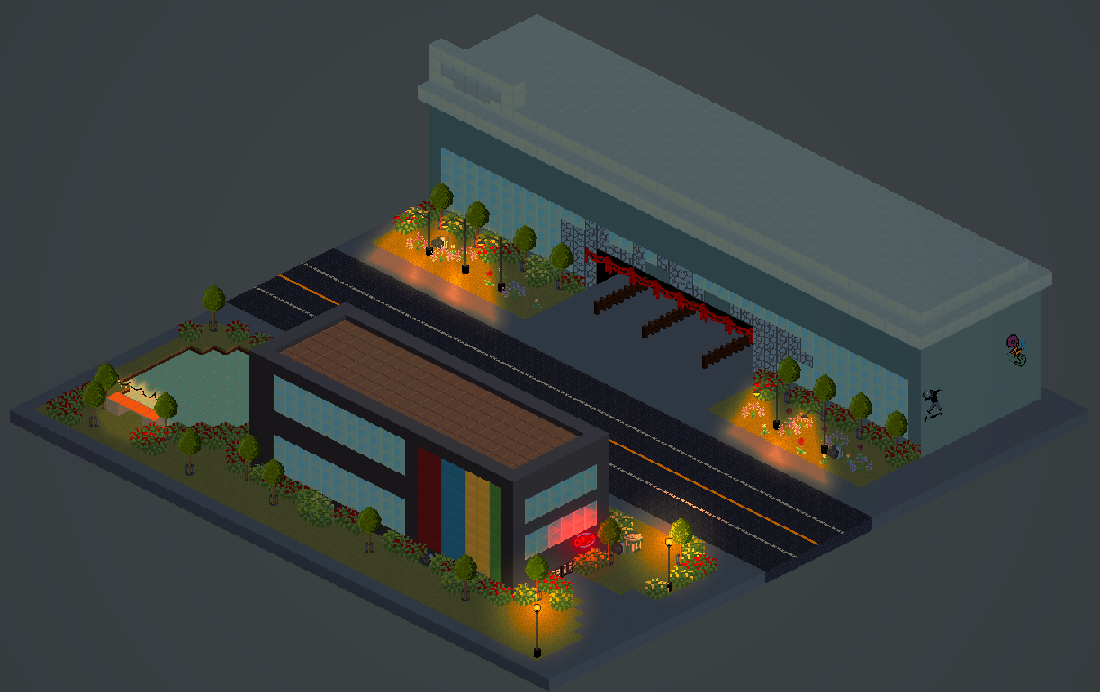
Some
Intersections

Slide 14
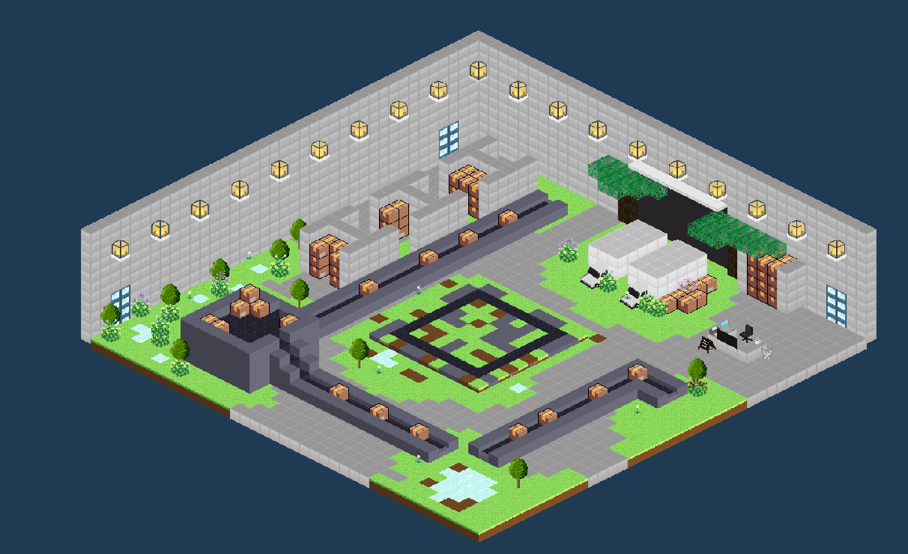
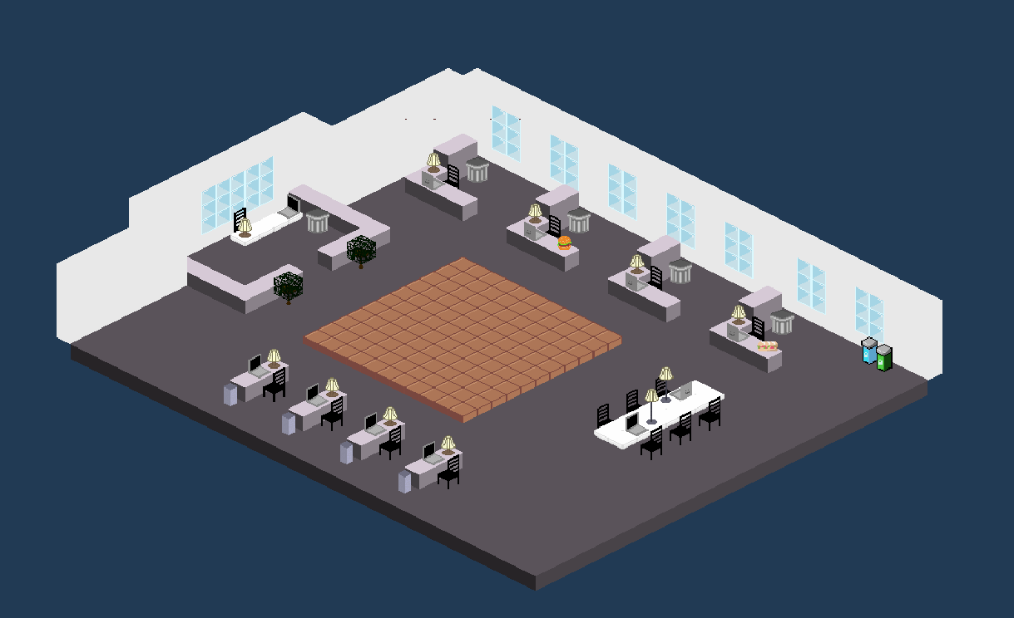
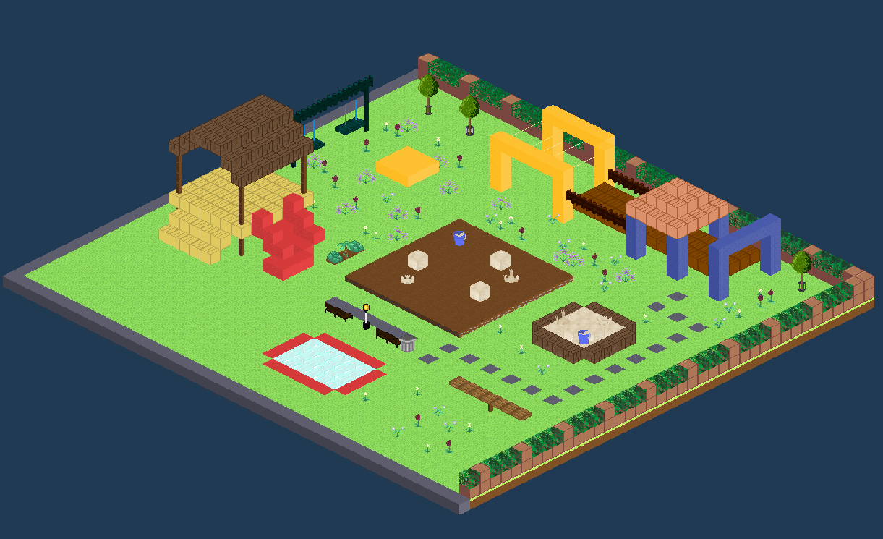
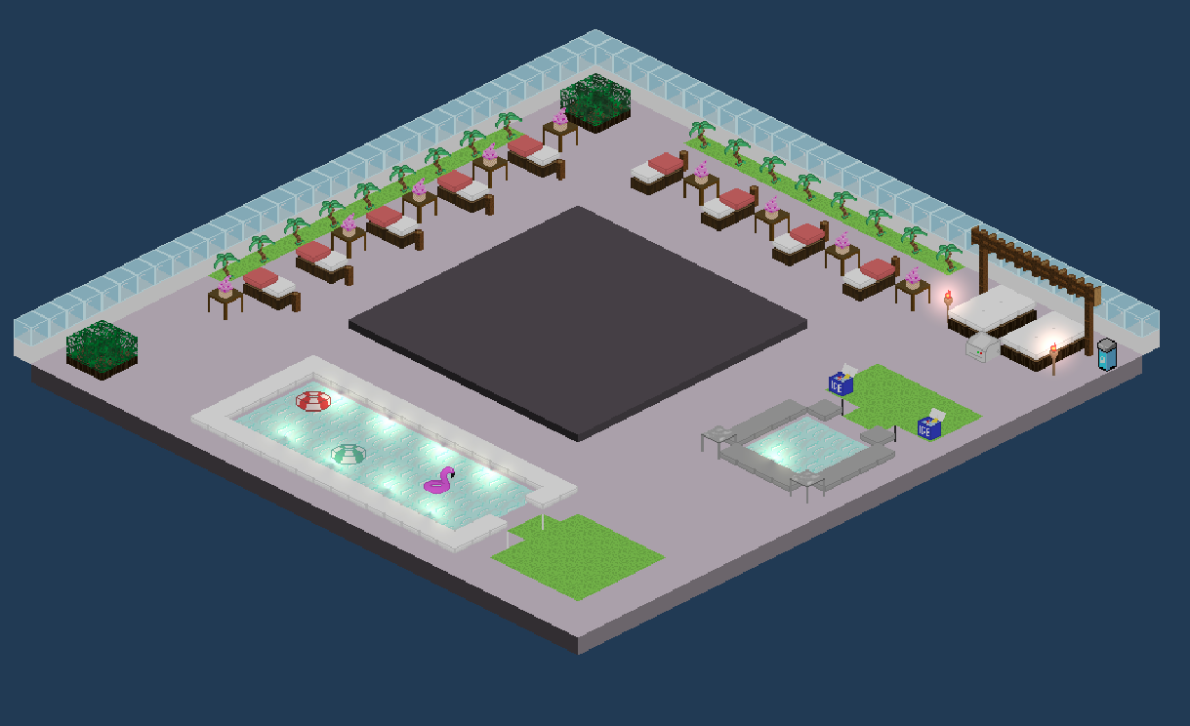
Some
Dungeons

Slide 15

Generation

Slide 16
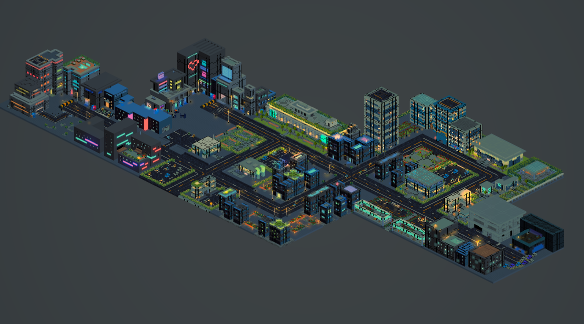
Generation

Slide 17
Mechanics

Slide 18
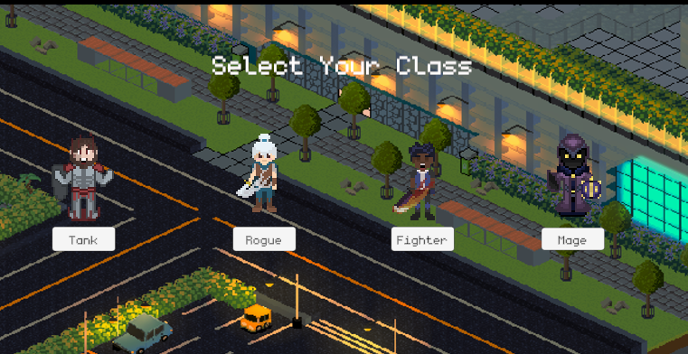
Character Class Selection

Slide 19
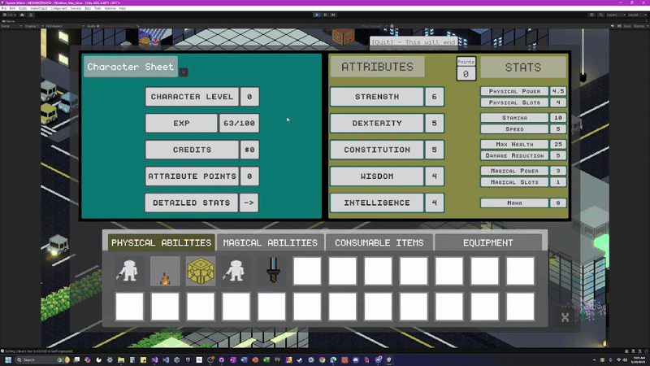
Gain Experience

Slide 20
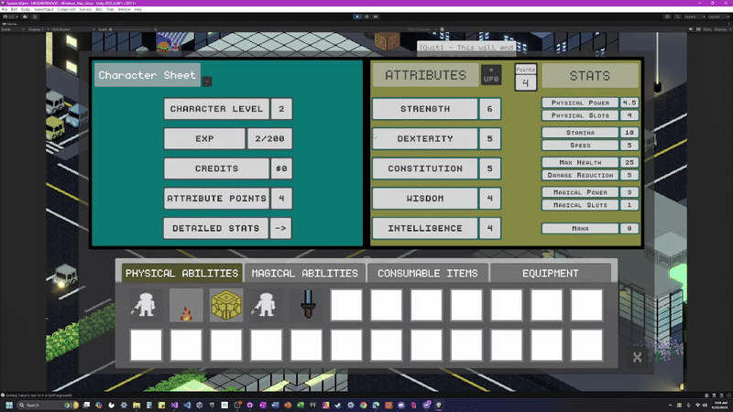
Upgrade Attributes & Stats

Slide 21
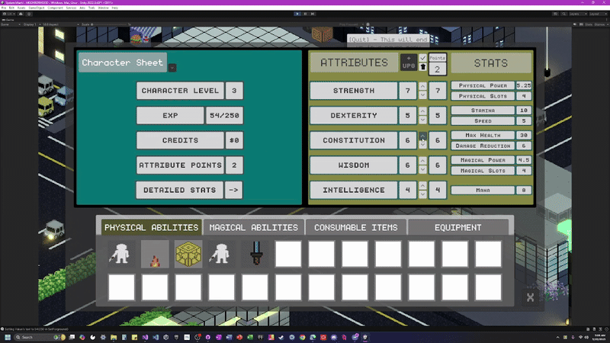
Upgrade Attributes & Stats

Slide 22
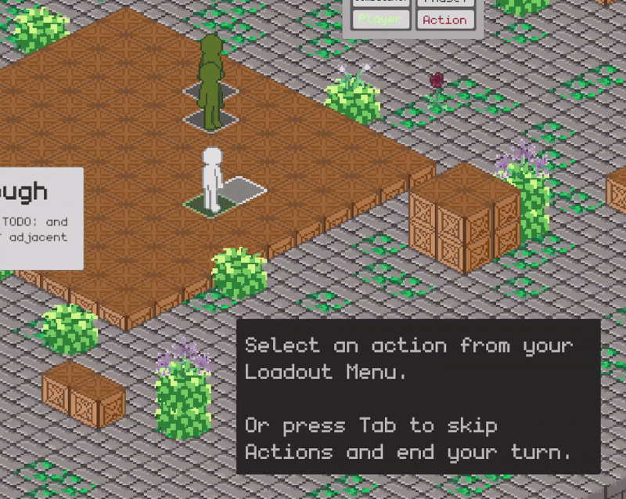
Dynamic Targeting Patterns

Slide 23
Thanks!
Questions? Feedback?

